Slide 1
Algorithmic and High-Frequency Trading AI & Machine Learning
Ken Liu

Slide 2
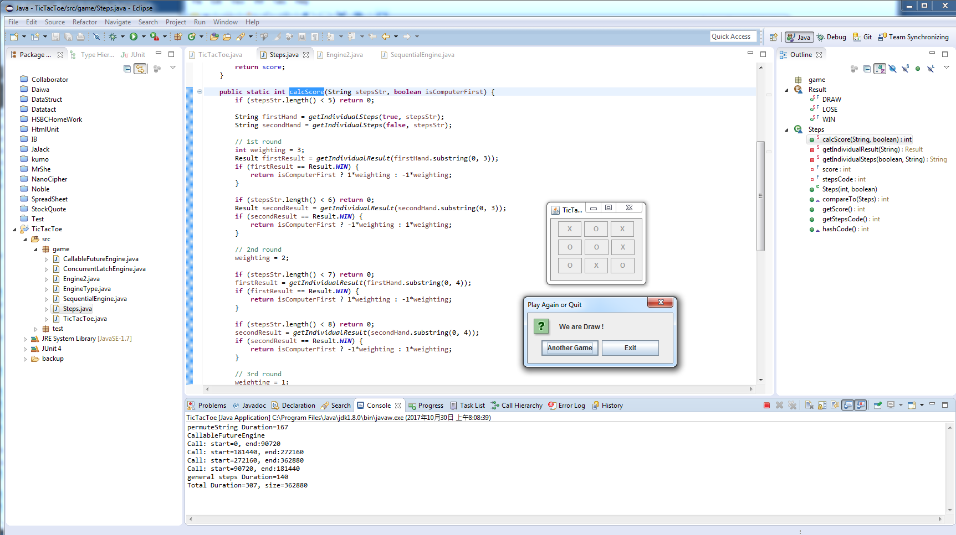
Introduction to AI - First AI Boom
Tick Tac Toe Example

Slide 3
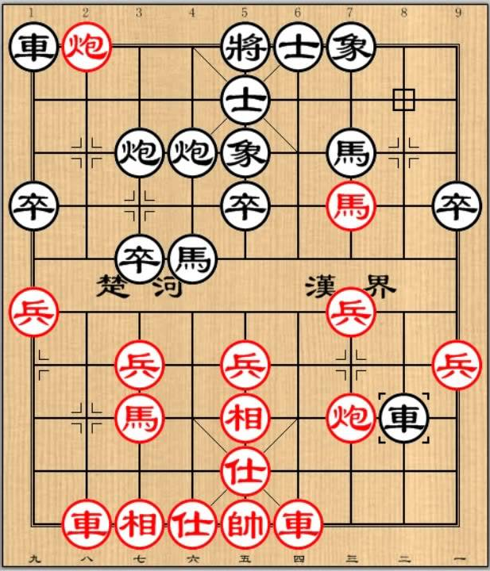

Introduction to AI - First AI Boom
Do I need to be a good chess player to write a good chess game?
No need. Computer just evaluate the game tree. Advanced Level means evaluating more level at each steps. Moreover, towards the end game, computer becomes faster (as fewer steps to evaluate) while human players tends to spend more time to think of each of steps carefully.

Slide 4
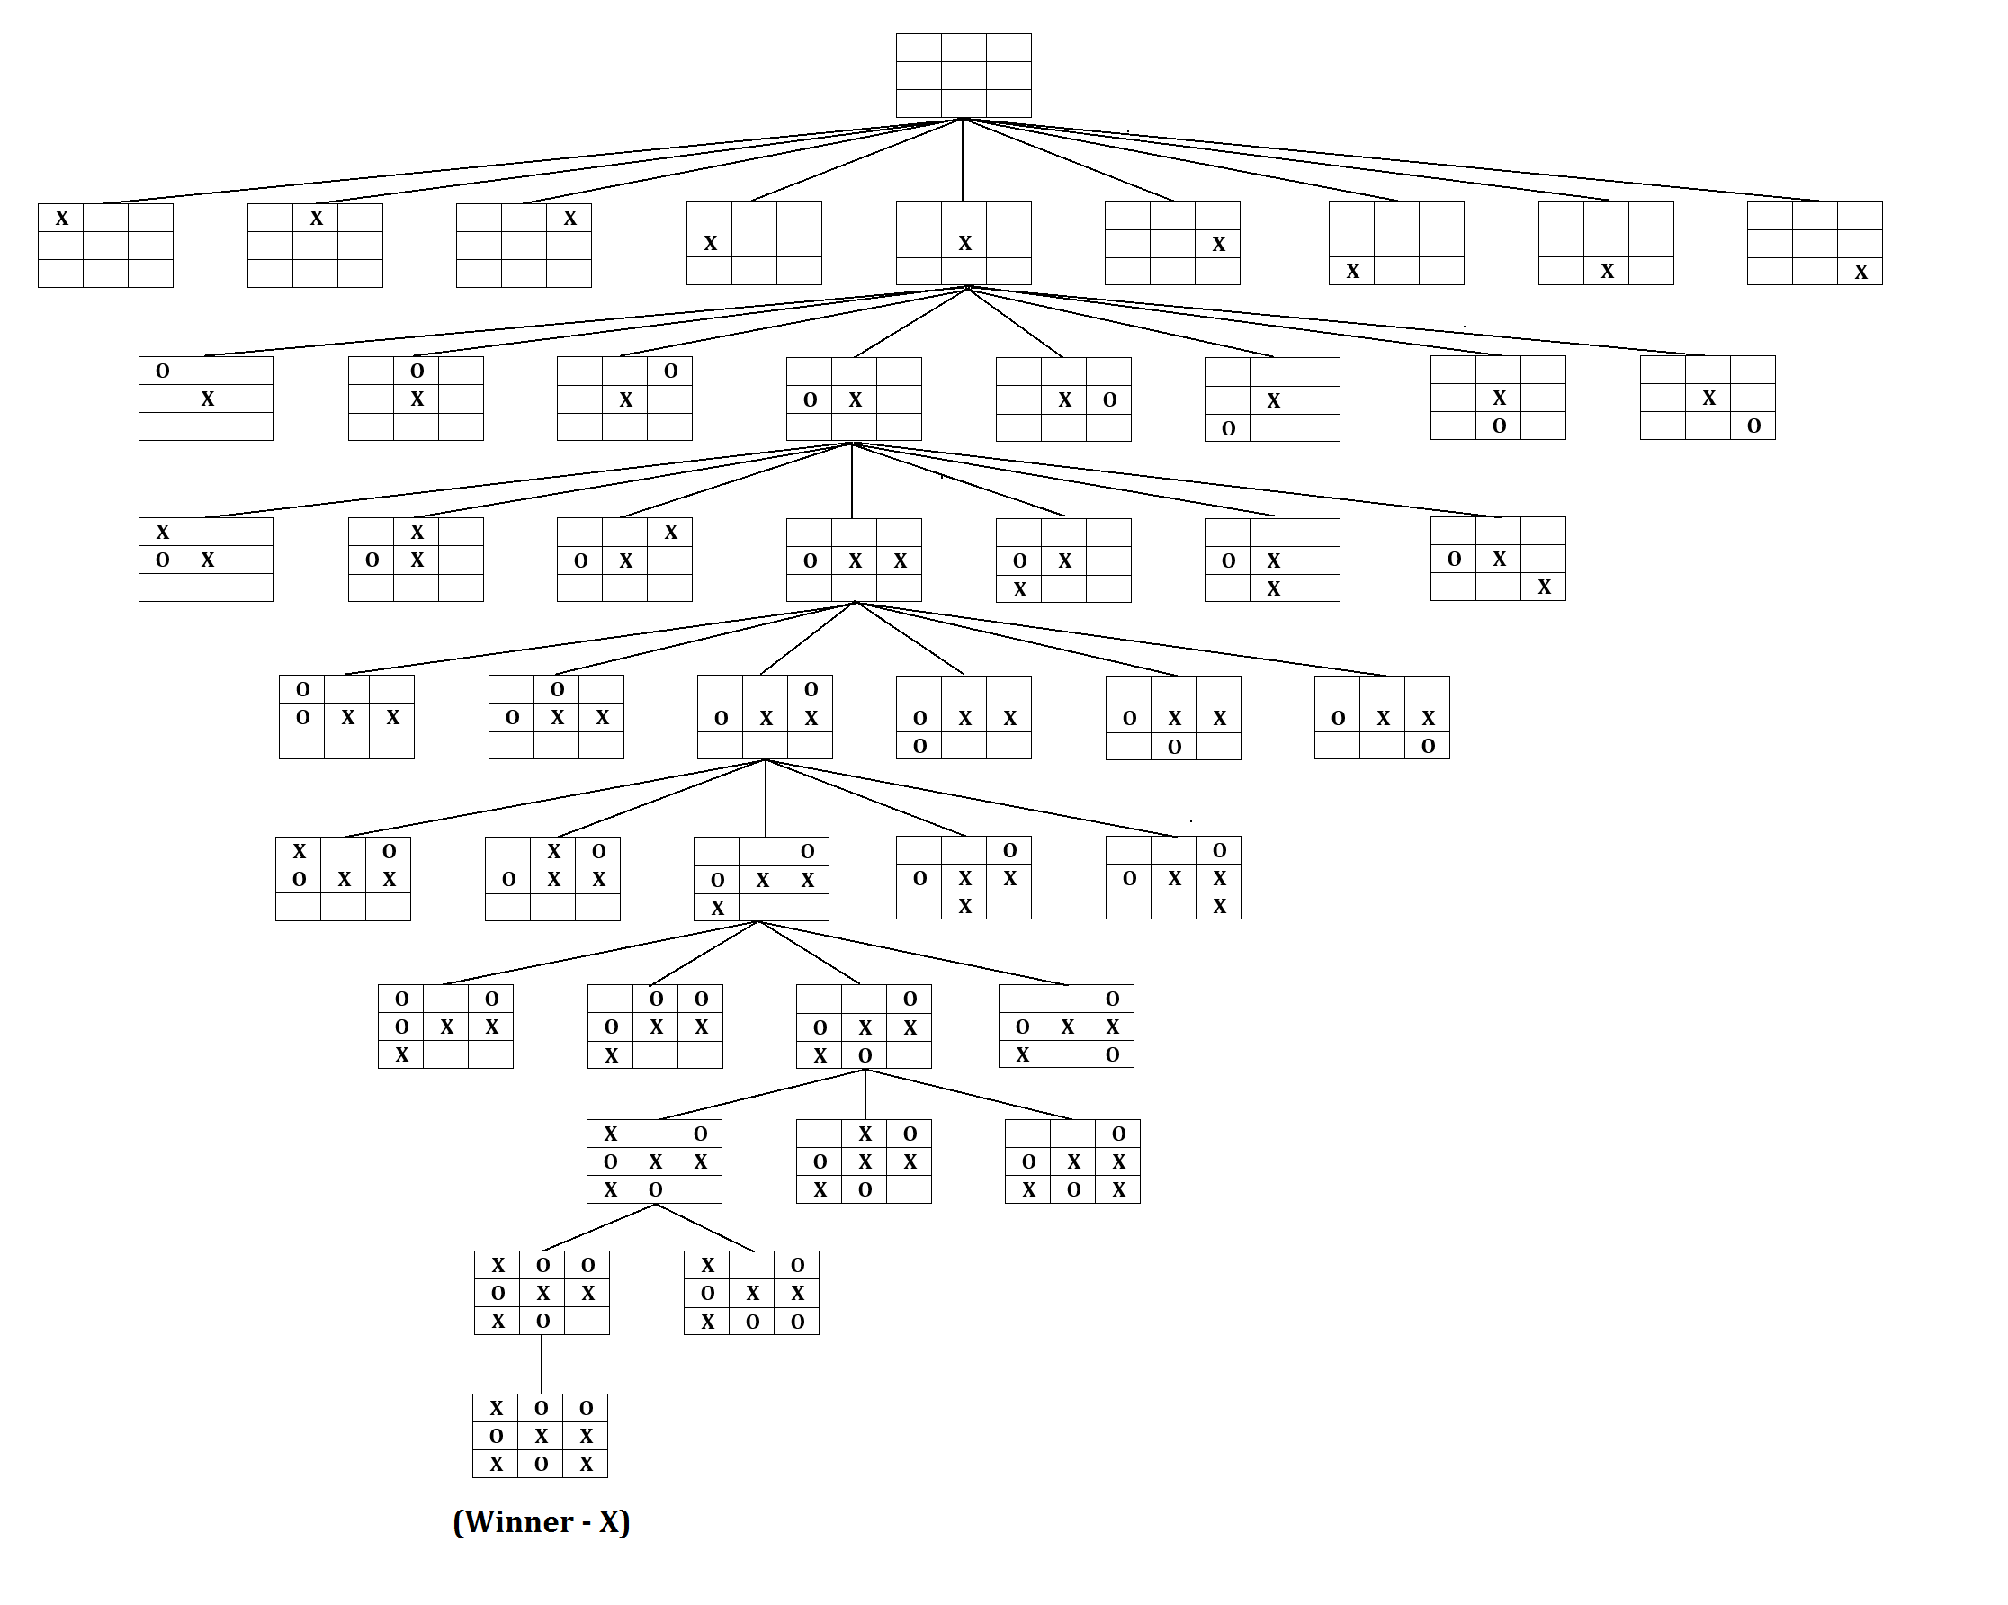
Introduction to AI - First AI Boom
Game Search Tree

Slide 5
Introduction to AI - First AI Boom
The first AI boom came in the late 1950s.
Search program was based on fixed rules dividing cases.
Write out every possible pattern as machine can calculate much faster than a human can.
A machine will keep searching a million times and eventually will find the best answer.
The most popular search methods were depth-first search (DFS) and breadth-first search (BFS).

Slide 6
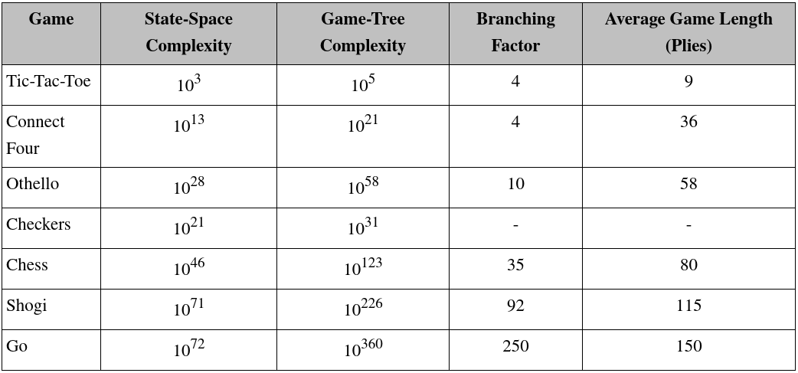
Introduction to AI - First AI Boom

Slide 7
Introduction to AI - First AI Boom
Search Optimization
Minimax
https://www.youtube.com/watch?v=KU9Ch59-4vw
Alpha–beta pruning
https://www.youtube.com/watch?v=xBXHtz4Gbdo
Key Points: State-Space (Complete Information and deterministic), Search Tree (Brute-force, Heuristic, Adversarial), Goal (Score, Weighting)

Slide 8
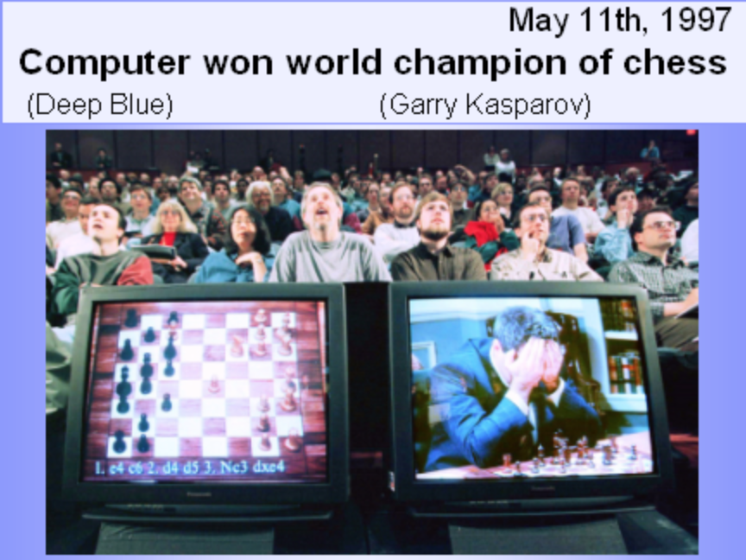
Introduction to AI - First AI Boom
Frame Problem
A machine can achieve great success in the field of Chess because the searching space is limited (set in a certain frame) in advance
Machine follow detailed rules set by a human. It is far from achieving actual AI. Therefore, the first AI boom cooled down rapidly with disappointment.
1997 News – IBM Deep Blue beats World Chess Champion Garry Kasparov

Slide 9
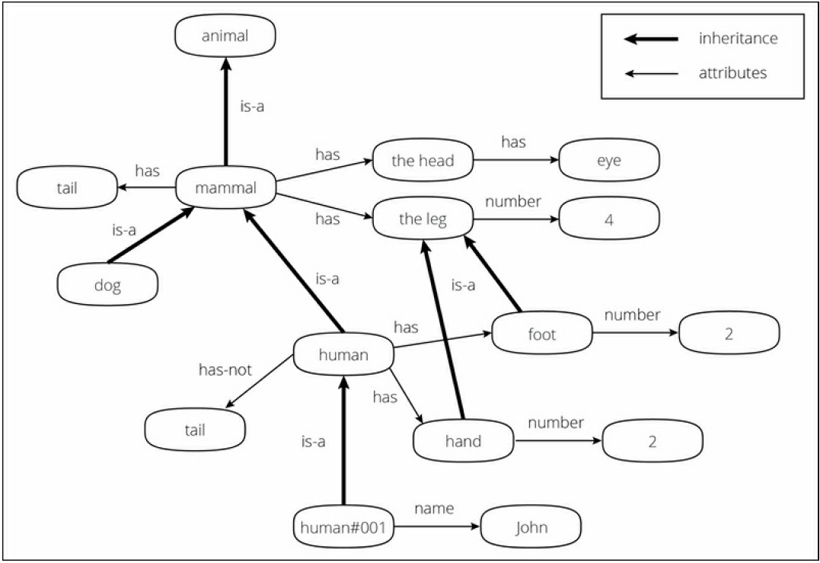
Introduction to AI - Second AI Boom
The second AI boom came in the 1980s.
Knowledge Representation (KR) and Expert system was booming and intended to describe knowledge that a machine could easily understand

Slide 10
Introduction to AI - Second AI Boom
Problems and Limitations
Inputting all real-world knowledge requires an almost infinite amount of work (Back then, Internet and Web were not existed yet)
Machine does not understands the actual meaning of the knowledge. Even if the knowledge is structured and systemized, a machine understands it as a mark and never understands the concept. Machine just compare the data and assume meaning based on the dictionary.
For example, if you know the concept of "apple" and "green" and are taught "green apple = apple + green", then you can understand that "a green apple is a green colored apple" at first sight, whereas a machine can't. This is called the symbol grounding problem and is considered one of the biggest problems in the AI field, as well as the frame problem.

Slide 11
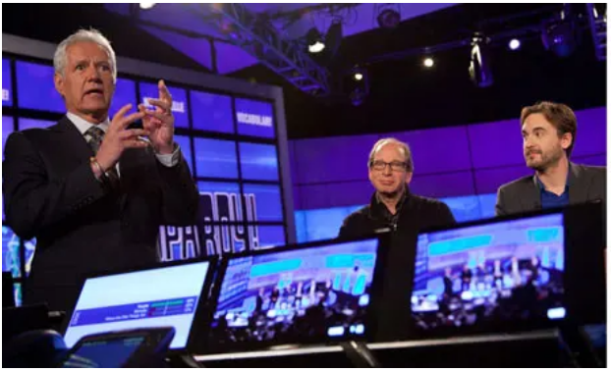
Introduction to AI - Second AI Boom
Today the Internet is commonly used and we can obtain enormous amounts of open data from the Web. (Has Google search become Expert System?)
Cyc build an inference engine based on the database of this knowledge, called knowledge base.
IBM computer Watson wins Jeopardy clash

Slide 12
Introduction to AI – Approaches
Symbolic: explore the possibility that human intelligence could be reduced to symbol manipulation (Human express knowledge in language which is symbols)
Cognitive simulation: defining heuristic algorithms in order to simulate human cognitive abilities, e.g., reasoning, problem solving, object recognition, and learning. We try to discover elementary concepts and rules which are used by a human being for solving generic problems.
Logic base: machines did not need to simulate human thought, but should instead try to find the essence of abstract reasoning and problem solving, regardless of whether people used the same algorithms (e.g. LISP programming language encode the logic)

Slide 13
Introduction to AI – Approaches
Evolutionary: a form of optimization search. They may begin with a population of organisms (the guesses) and then allow them to mutate and recombine, selecting only the fittest to survive each generation (refining the guesses). Examples are genetic programming, ant colony or particle swam optimization.
Connectionist: the learning is a result of associations between stimuli and responses to stimuli. Associations become strengthened if an organism is trained with stimulus-response exercises, and they become weakened if such training is discontinued (bio-inspired model and the best example is Neural Network)
Computational and Statistical: learning from the experience (data) and derive the statistical meaning of inference from the data (Machine Learning).

Slide 14
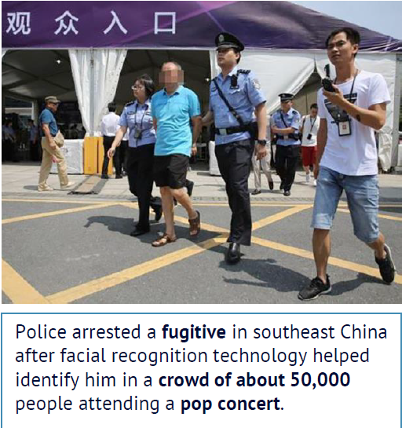
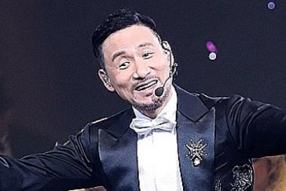
Introduction to AI - Third AI Boom (Now)
Machine Learning: a branch of AI and the key driver is (big) data from Internet, Mobile and IoT (Internet of Things which are sensors, smart devices etc.)
Example: 1.3 billions of faces in China, how can tell a computer to recognize a person?
# pseudo code
Color in {brown, yellow, black}
Has {hair, eye * 2, nose, mouth,
ear * 2 ……}
Eye: {black, white, brown ……..}
……………….
https://www.npr.org/sections/therecord/2018/05/23/613692526/thanks-to-ai-a-3rd-person-is-arrested-following-a-pop-superstars-concert

Slide 15
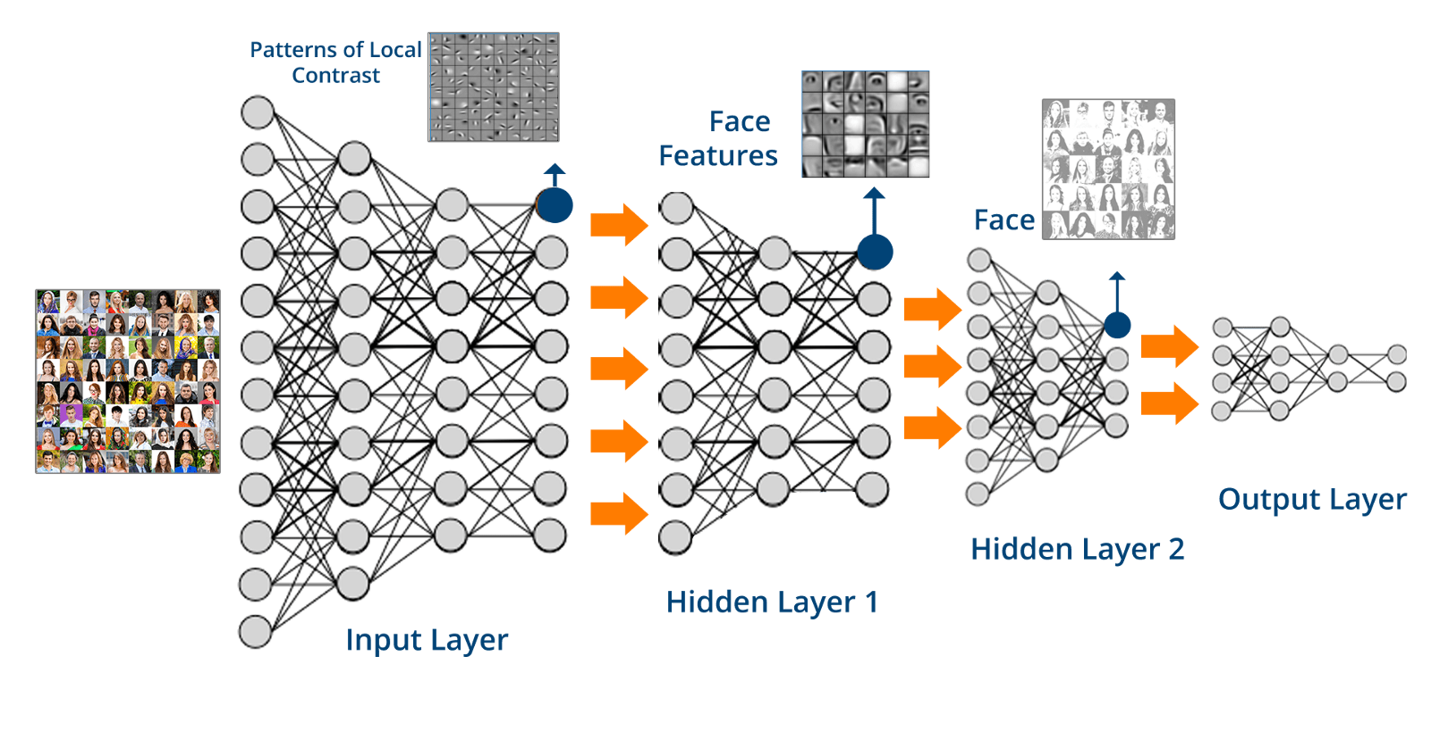
Introduction to AI - Third AI Boom (Now)
Learn from data rather than explicitly program the logic: let the computer see many examples (face, name) and learn how to represent it in a Deep Neural Network (brain-like structure)

Slide 16
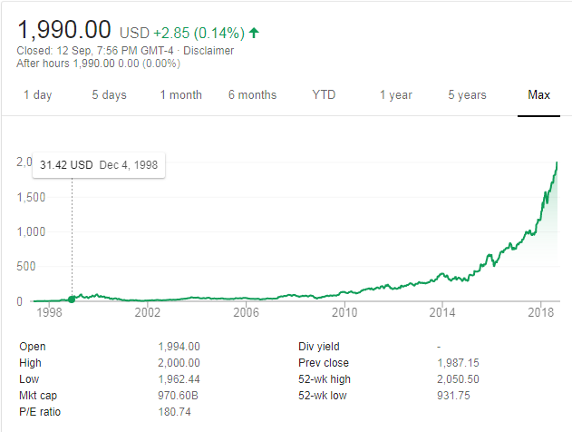

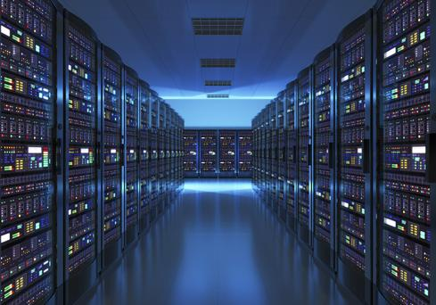
Introduction to AI - Third AI Boom (Now)
Commodities Infra (Cloud) : rent super computers (from AWS, Google Cloud etc.) for few hours to train the machine learning model. (Training vs Predicting time)
Notes:
Long nVidia is better than so many quant trades !

Slide 17
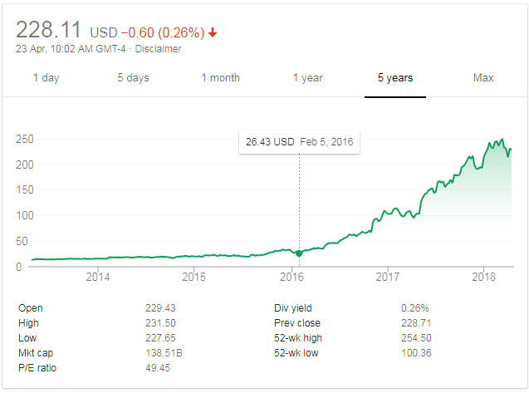

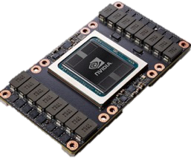
Introduction to AI - Third AI Boom (Now)
Hardware Parallelization: GPU (Graphics Processing Unit) substantially improve the speed of calculation (nVidia stock price has gone up substantially)
Tesla V100 : 120 TFLOPS
One more usage: https://easyhashing.com/en/
Notes:
Long nVidia is better than so many quant trades !

Slide 18
Introduction to AI - Third AI Boom (Now)
Algorithms: new techniques in processing data in parallel. Such as Map-Reduce which distribute the program logic to the data and combine the results.
Breakthrough: Deep Learning solve some bottlenecks previously encountered in Neural Networks and results in commercial success.
2013 Playing Atari with Deep Reinforcement Learning
https://arxiv.org/abs/1312.5602
2016 AlphaGo
https://www.theverge.com/2017/5/25/15689462/alphago-ke-jie-game-2-result-google-deepmind-china

Slide 19
Introduction to AI - Third AI Boom (Now)
Community and Competition: Open Source APIs and prize awards
Netflix Prize: https://en.wikipedia.org/wiki/Netflix_Prize
https://www.netflixprize.com/leaderboard.html
(open competition for the best collaborative filtering algorithm to predict user ratings for films, based on previous ratings without any other information about the users or films, i.e. without the users or the films being identified except by numbers assigned for the contest. On September 21, 2009, the grand prize of US$1,000,000 was given to the BellKor's Pragmatic Chaos team which bested Netflix's own algorithm for predicting ratings by 10.06%.)
IBM’s Watson Analytics platform is now open to everyone: https://thenextweb.com/apps/2014/12/04/ibms-watson-powered-analytics-platform-now-open-everyone/

Slide 20
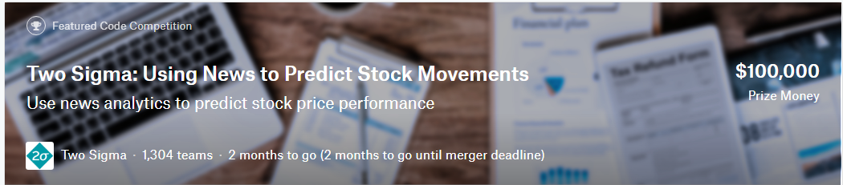
Introduction to AI - Third AI Boom (Now)
Kaggle Competitions: Two Sigma: Using News to Predict Stock Movements
The challenge is ingesting and interpreting the data to determine which data is useful, finding the signal in this sea of information. Two Sigma is passionate about this challenge and is excited to share it with the Kaggle community.
By analyzing news data to predict stock prices, Kagglers have a unique opportunity to advance the state of research in understanding the predictive power of the news. This power, if harnessed, could help predict financial outcomes and generate significant economic impact all over the world.
Market data provided by Intrinio.
News data provided by Thomson Reuters

Slide 21
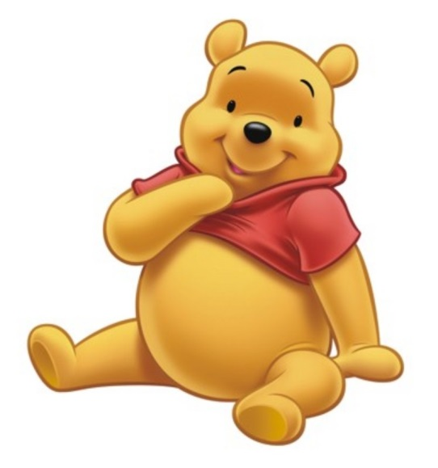
Use Cases – Face Recognition
Face recognition: Face (iPhoneX FaceId), Security Camera
http://www.telegraph.co.uk/news/2017/03/20/beijing-park-uses-face-recognition-software-wipe-toilet-paper/
How to send Winnie-the-Pooh

Slide 22

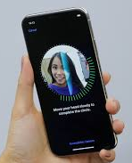
Use Cases – Face Recognition
化妝就係你落咗妝，我仲認得你，你落咗妝，我唔認得你，嗰啲叫做喬裝。
If you can still unlock FaceId, it’s called make-up, otherwise it’s a “fake-up”
上咗妝後 FaceId 仲認得叫做化妝，認唔到嘅叫做喬裝

Slide 23
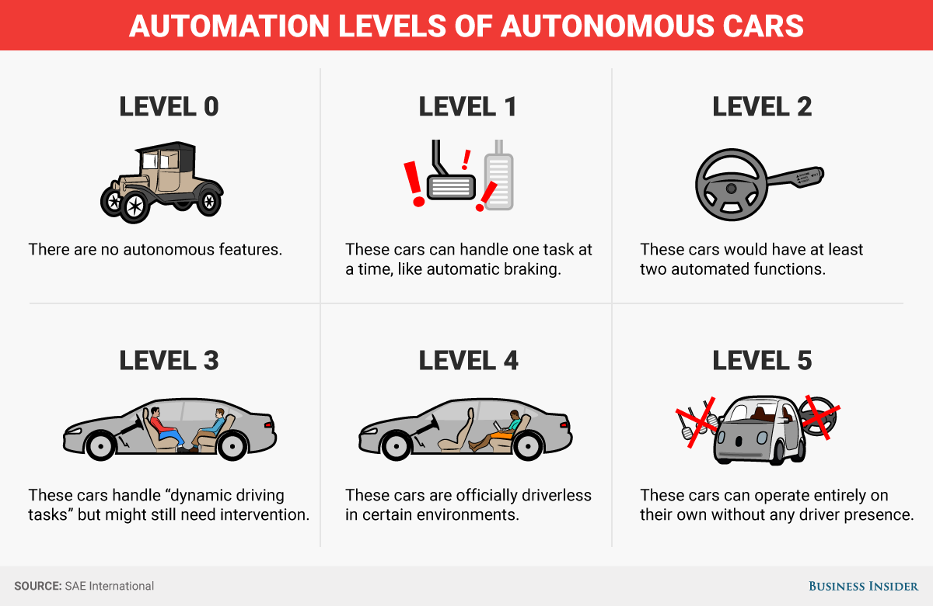
Use Cases – Self Driving Car

Slide 24
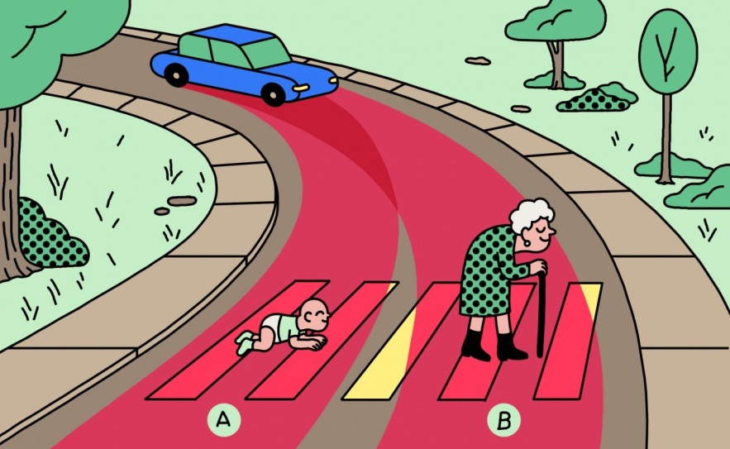
Use Cases – Self Driving Car
Challenges
Data & Algo biased:
Should a self-driving car kill the baby or the grandma?
Driverless Cars Will Have to Break the Law
Responsibility: in case of breaking the law, who should go to jail (the car owner or the car company)
Less tolerant on machine than human
2019: Fanlan bus incident
2017: Taipo road incidents

Slide 25
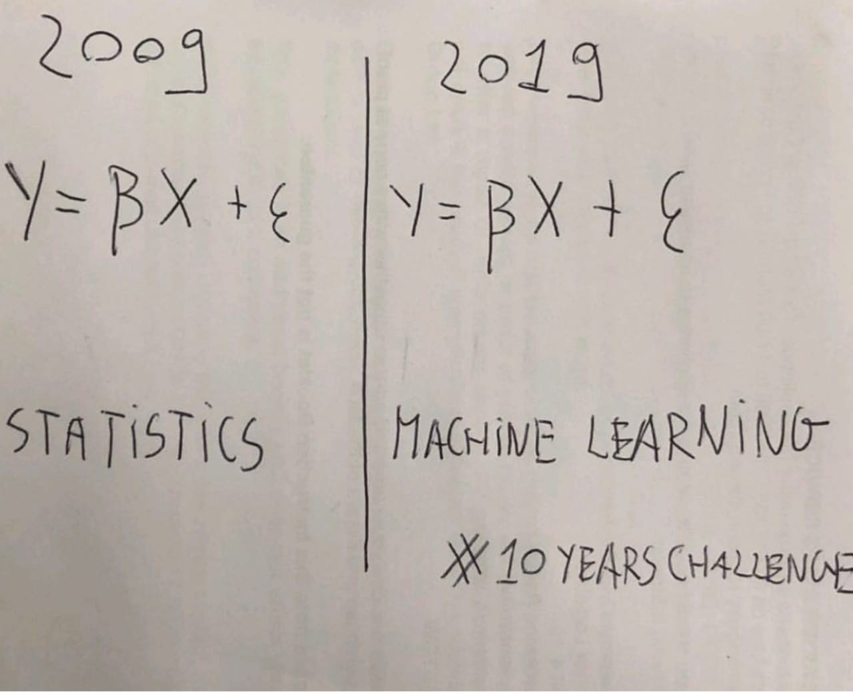
Machine Learning

Slide 26
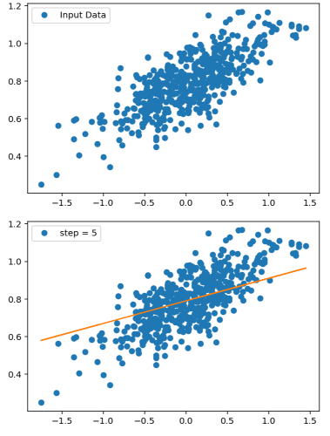
Example – Linear Regression
Learning Regression (the model)
y = ax + b
Input Data -> Output
Parameter (a, b)
Loss/Objective function
Gradient Descent
Training (no. of steps)
Code Example

Slide 27
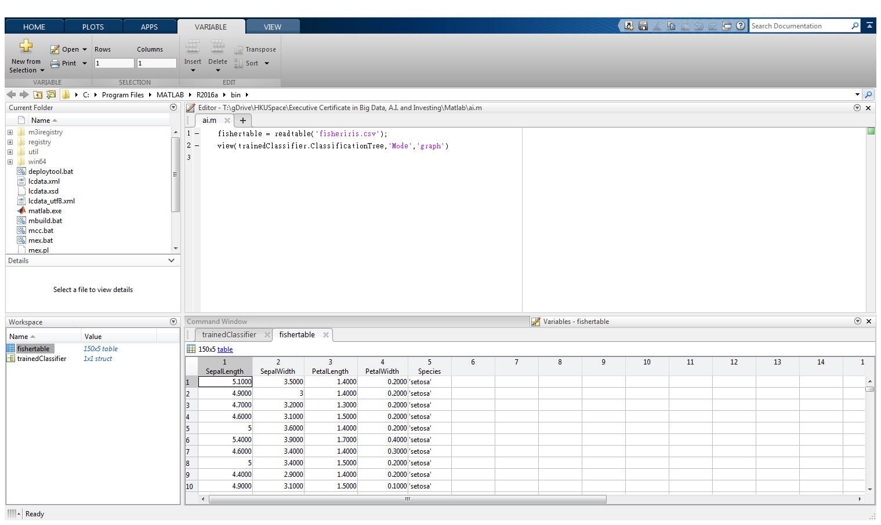
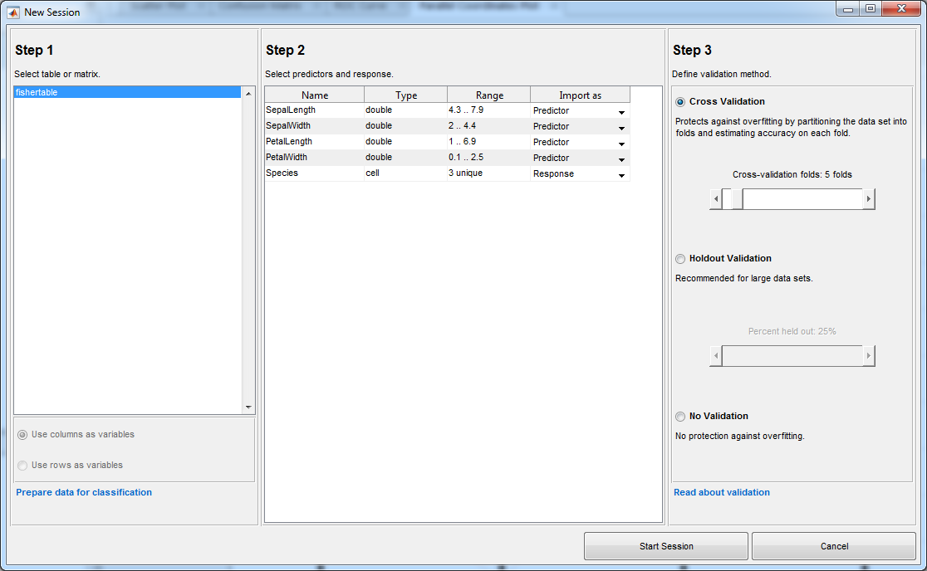
Demo - Decision Tree

Slide 28
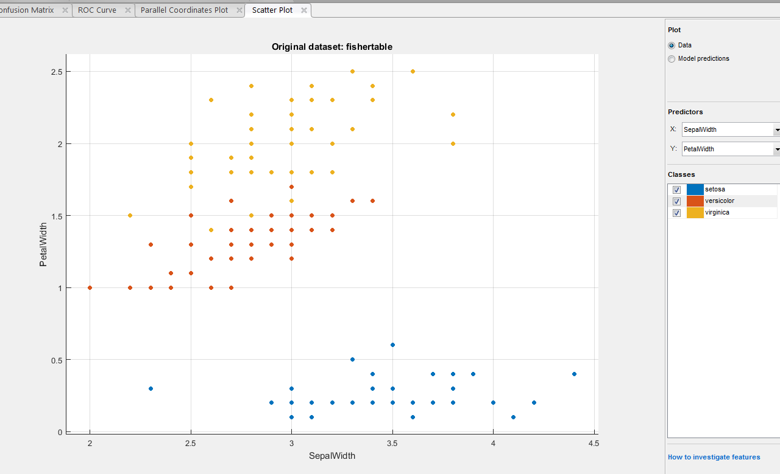
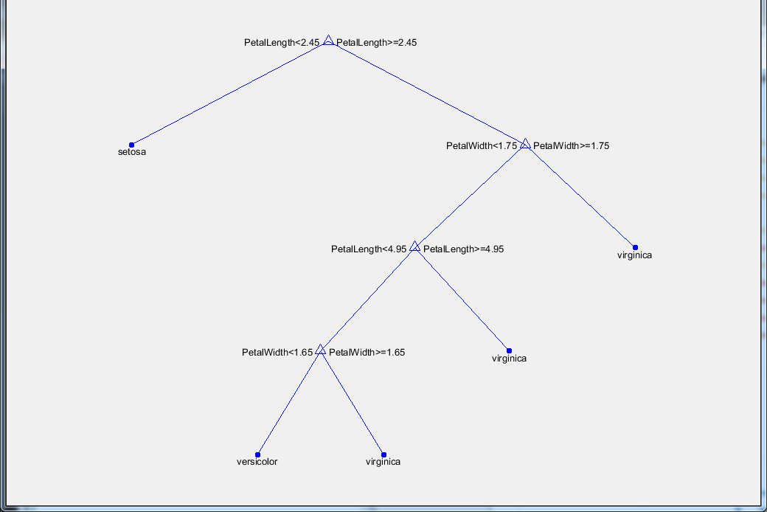
Demo – Decision Tree

Slide 29

Demo – Decision Tree
Go from observations about an item (represented in the branches) to conclusions about the item's target value (represented in the leaves).
Tree models where the target variable can take a discrete set of values are called classification trees; in these tree structures, leaves represent class labels and branches represent conjunctions of features that lead to those class labels. Decision trees where the target variable can take continuous values (typically real numbers) are called regression trees.
(Notes: Automatic Rule-based
High Bias -> Random Forest)

Slide 30
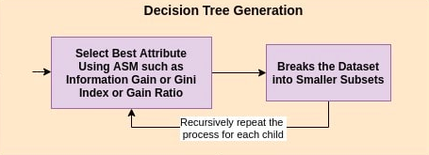
Demo – Decision Tree
Algorithm
Select the best attribute using Attribute Selection Measures(ASM) to split the records.
Make that attribute a decision node and breaks the dataset into smaller subsets.
Starts tree building by repeating this process recursively for each child

Slide 31
Machine Learning - Basics
Dataset + Learning Algorithm + Objective Function + Model
Learning: ^E(Experience) -> ^(P(Performance) of T(Task))
Experience: Dataset (features)
Task: {Classification, Regression, Clustering,, Translation, Anomaly detection....}
Performance: {Test Data, Training Data, Validation Data}

Slide 32
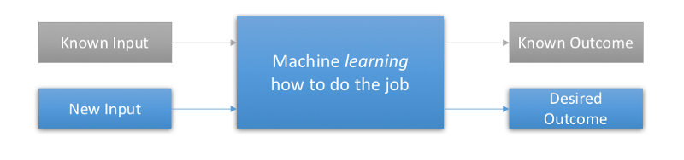
Machine Learning - Basics
Supervised Learning: presented with example inputs and their desired outputs, given by a "teacher“. The goal is to learn a general rule that maps inputs to outputs (i.e. learn a function of g(x) = y)
The dataset commonly know as feature vectors (e.g. sepal length, sepal width)
It requires large human efforts to manually labelled the data. Nonetheless, the internet already provide many source of labelled data: movies reviews, subtitles, tag your friend in photos, social media reactions

Slide 33
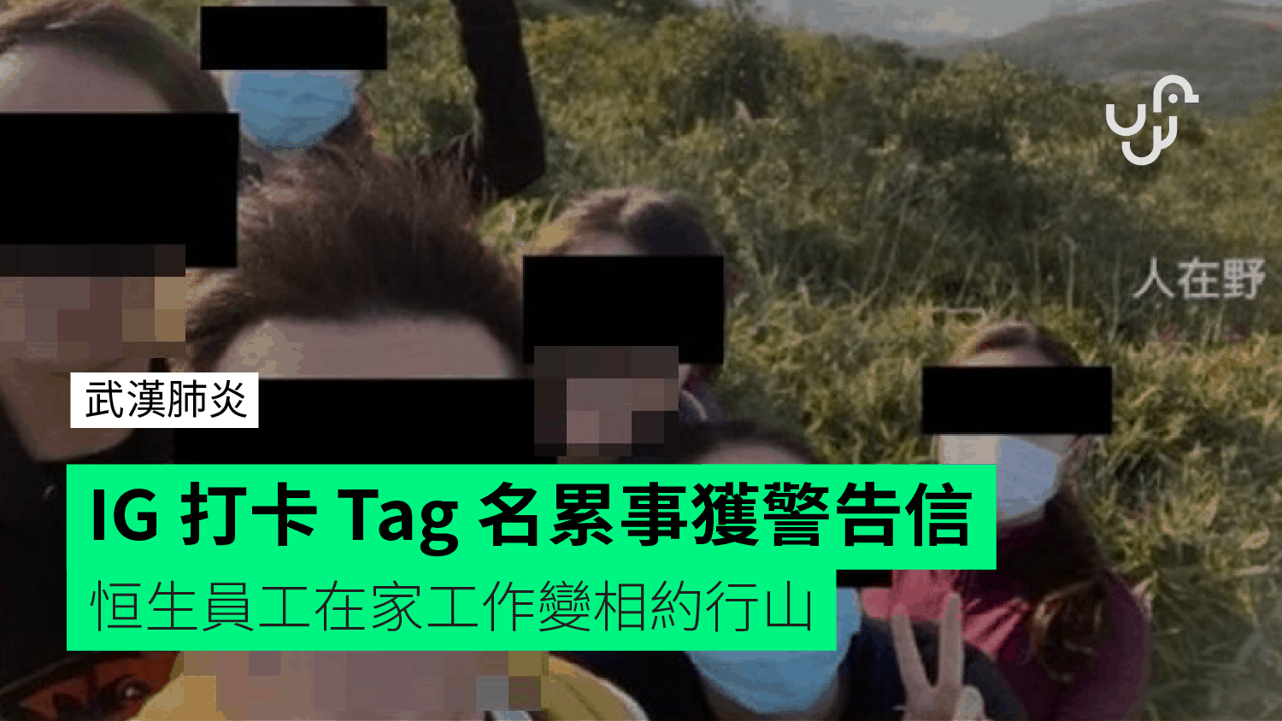
Machine Learning - Basics
Where to find labelled dataset?
Kaggle Dataset
Google Dataset Search
AWS Open Data
Human Data Labeler
Amazon Mechanical Turk
And…………You !
(e.g. tagged your friends in Facebook or IG)

Slide 34
Machine Learning - Basics
Classification: predict a discrete number of values
Binary Classification : when there is only two classes to predict, usually 1 or 0; True or False.
Multi-Class Classification: when there are more than two class labels to predict we call multi-classification task. e.g. predicting 3 types of iris species; image classification problems where there are more than thousands classes(cat, dog, fish, car,…).
Regression: predict continuous valued output. For example, given a size of the house predict the price (real value).

Slide 35
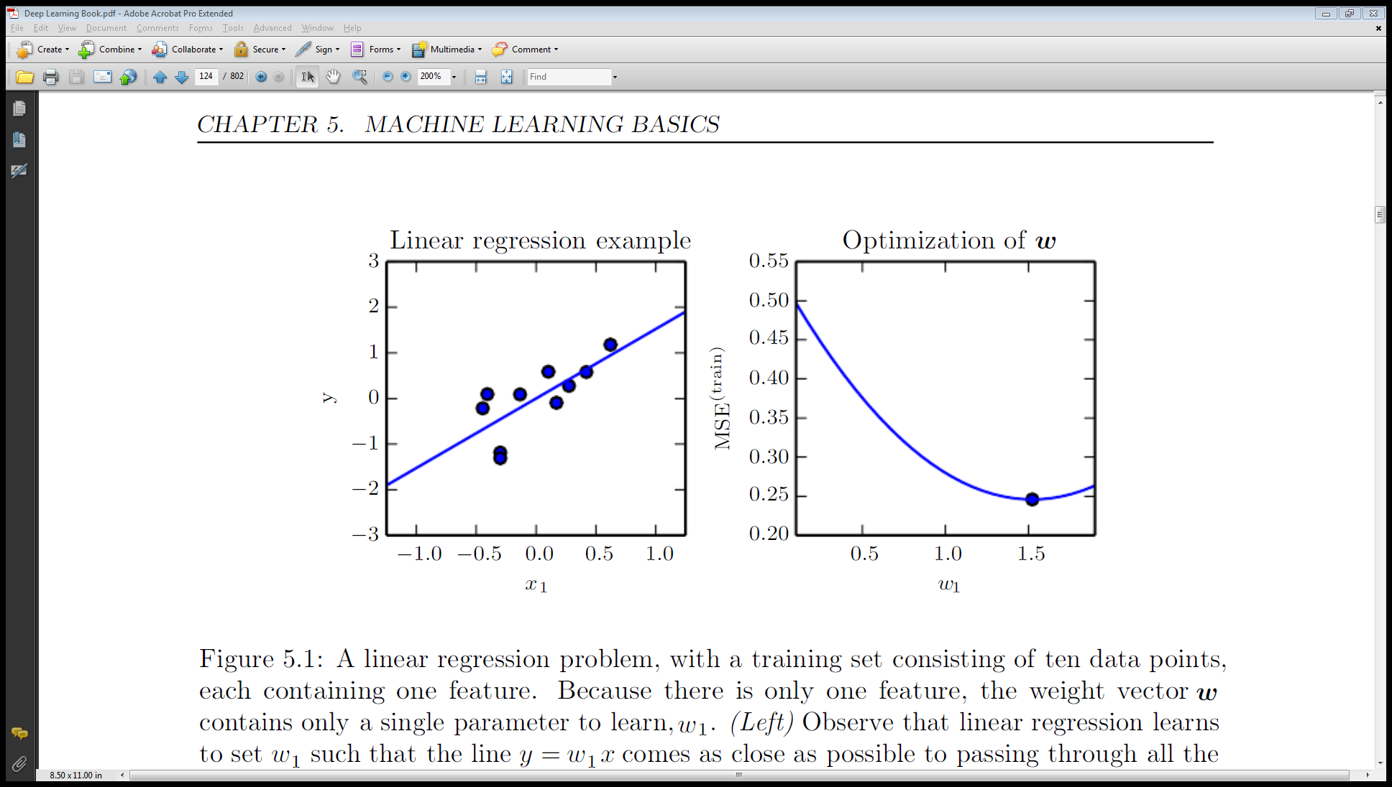
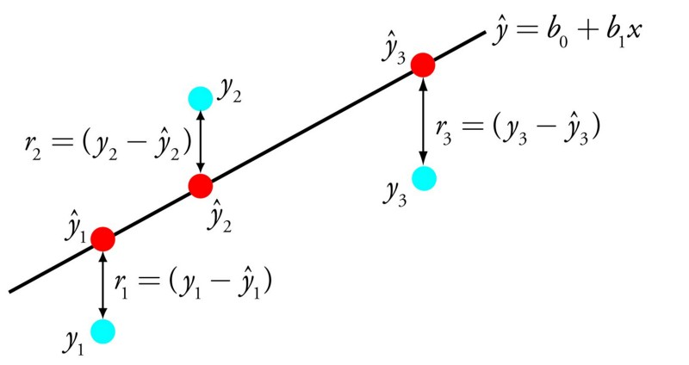
Machine Learning - Objective function
Objective function: a way to measuring the quality the model. This function, taking data and model parameters as arguments, can be evaluated to return a number. Any given problem contains some parameters which can be changed; our goal is to find values for these parameters which either maximize or minimize this number. (Similar terms: Cost function, Loss Function)

Slide 36

Machine Learning - Gradient Descent
Gradient Descent: an optimization algorithm used to find the values of parameters (coefficients) of a function (f) that minimizes a cost function (cost).
Notes: Hyper-parameters are parameters whose values are set prior to the commencement of the learning process. By contrast, the values of other parameters are derived via training.

Slide 37
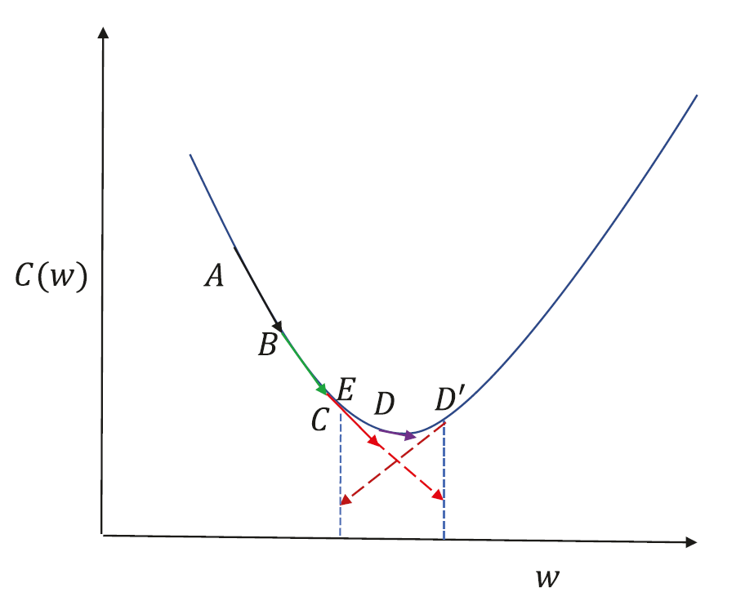
Machine Learning – Learning Rate
Cost function between A and C is almost linear, and so gradient descent works well.
From point C, if we take a small learning rate at C, we will end up at D, which is reasonable enough since it doesn’t overshoot the point of minima.
A larger step size at C will get us to D ', which is not desirable, because it’s on the other side of the minima.
A large step size at D ' would get us to E, and if the learning rate is not reduced the algorithm tends to toggle between points on either side of the minima, leading to oscillations

Slide 38
Machine Learning – Data Set
In-Sample: the data set used in the model training
Training Set: the labelled data used to train the underlying model during learning
Validation Set: a set of examples used to tune the parameters of a classifier
Cross Validation: select a number of folds to partition the data set. For each fold, trains a model using the out-of-fold observations. Assesses model performance using in-fold data and calculates the average test error over all folds. This method gives a good estimate of the predictive accuracy of the final model trained with all the data. It requires multiple fits but makes efficient use of all the data, so it is recommended for small data sets.
Holdout Validation: reserve certain % of the training data as test set. Train the model on the training set and assesses the performance with the test set. The resulting model is based on only a portion of the data, so it is recommended only for large data sets.
Out-Sample: the data set not seen by the model
Test Set: a set of examples used only to assess the performance of a fully-trained classifier

Slide 39
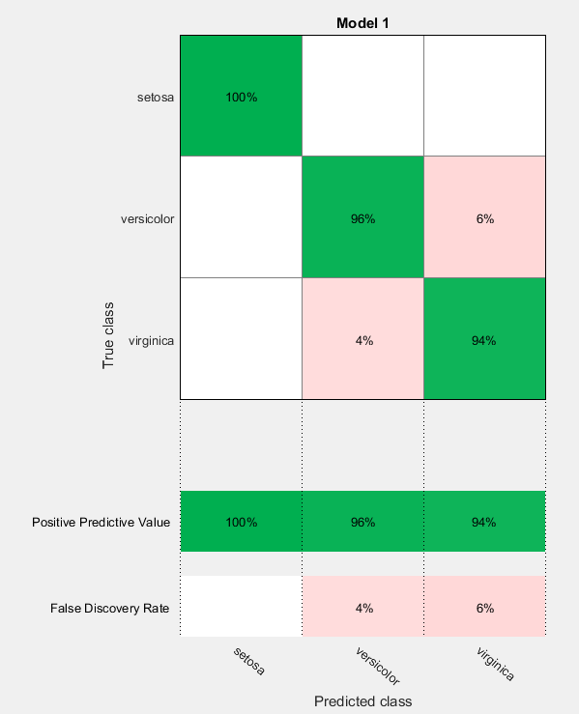
Machine Learning - Confusion Matrix
False Positive: indicates a given condition exists, when it does not. Type I error where the test is checking a single condition, and wrongly gives an affirmative (positive) decision.
False Negative: that indicates that a condition does not hold, while in fact it does. Type II error occurring in a test where a single condition is checked for and the result of the test is erroneously that the condition is absent.

Slide 40
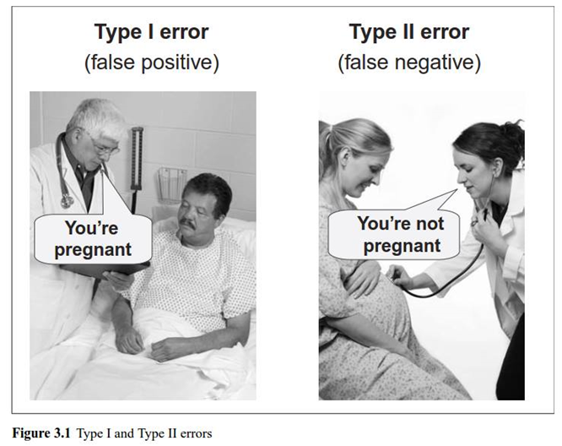
Machine Learning – Type I & II Errors
Discussion
Production Support
Vs
Email Spam
How about Legal and Law?

Slide 41
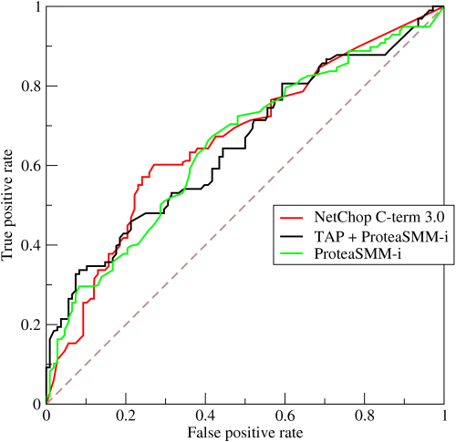
Machine Learning - ROC curve
Receiver Operating Characteristic (ROC) curve: plots the true positive rate against the false positive rate at various threshold settings. The true-positive rate is also known as sensitivity, recall or probability of detection in machine learning. The false-positive rate is also known as the fall-out or probability of false alarm and can be calculated as (1 − specificity). The ROC curve is thus the sensitivity as a function of fall-out.

Slide 42

Machine Learning - Accuracy
Accuracy vs Specificity
Example: Credit Card Fraud detection system (fraud is an anomaly event that happen only 1% in the dataset). If the system is able to predict Fraud or “No Fraud” in 99% accuracy, do you think it is good enough?
NO, a dumb system that always predict “No Fraud” will achieve 99% accuracy. Need to look specifically at the accuracy of the “No Fraud” cases (specificity).

Slide 43
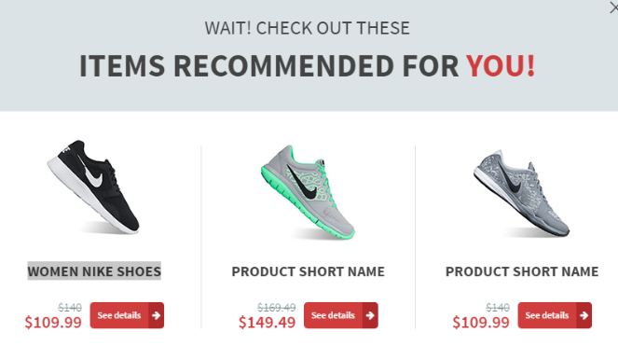
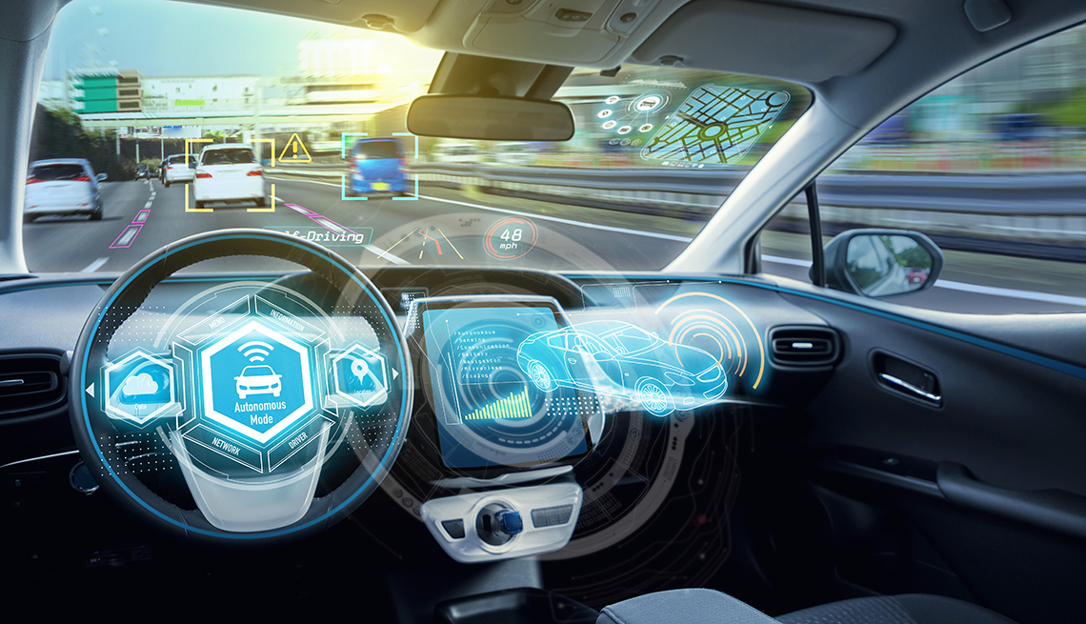
Machine Learning - Accuracy
How much accuracy/specificity is enough: 70%, 80%, 90%, 99% ??
It depends on the applications. Self driving cars require much higher accuracy than the product recommendation system.
Trading and investment predictions are generally not very high in accuracy.

Slide 44
Machine Learning - Workflow
Pre-process: determine the input for the machine learning model
Dataset: Collect, Clean and Normalize (e.g. scale the data into standard measure) the data
EDA (Exploratory Data Analysis): Visualize (e.g. scatter plot) the data to understand the key properties
Feature Selections: apply dimension reduction techniques (e.g. Principle Component Analysis or Factor Analysis) to see if the data (i.e. input features) can be reduced while maintain the similar predictive power.
(Note: Data collection and feature selection usually required in-depth domain knowledge to pick up the right dataset for training)

Slide 45
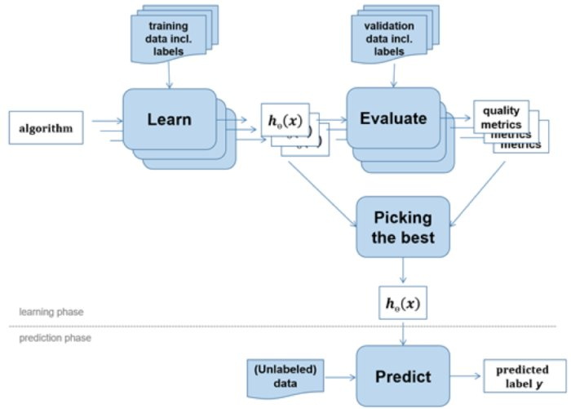
Machine Learning - Workflow
Training and Prediction
Choose Algorithm
Train (Learn) the model from data
Tune hyper-parameters
Evaluate the accuracy
Used the trained model for prediction

Slide 46

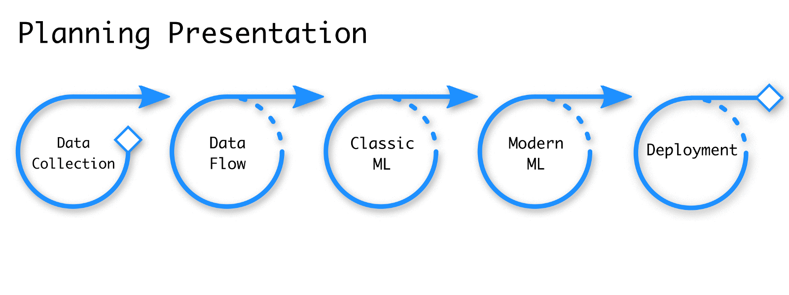
Machine Learning - Workflow

Slide 47
Data Analysis – Historical Tick Data
https://www.hkex.com.hk/eng/ods/historicalData.aspx
Historical Full Book - Securities Market (CSV Format) provides information on every order and trade of Main Board and GEM stocks in CSV format. File is available on a daily basis, normally at around 10:00pm.
$5,000/Month
Historical Order Book and Statistics Update - Securities Market provides intra-day order book and statistics information recorded on the HKEX's Main Board and GEM stocks in CSV format. File is available on a daily basis, normally at around 10:00pm.
$2,500/Month

Slide 48
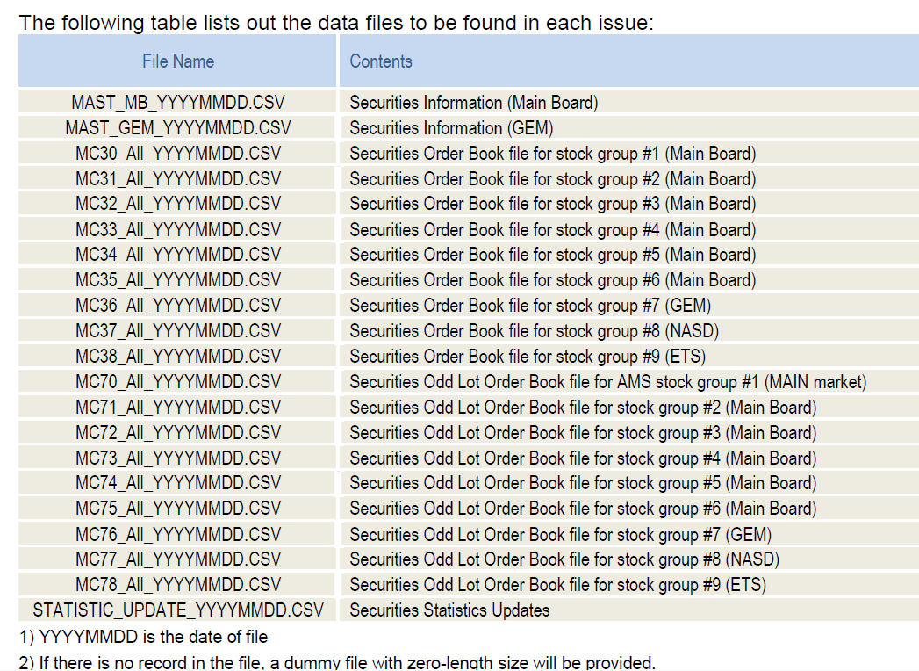
Data Analysis – Historical Tick Data

Slide 49
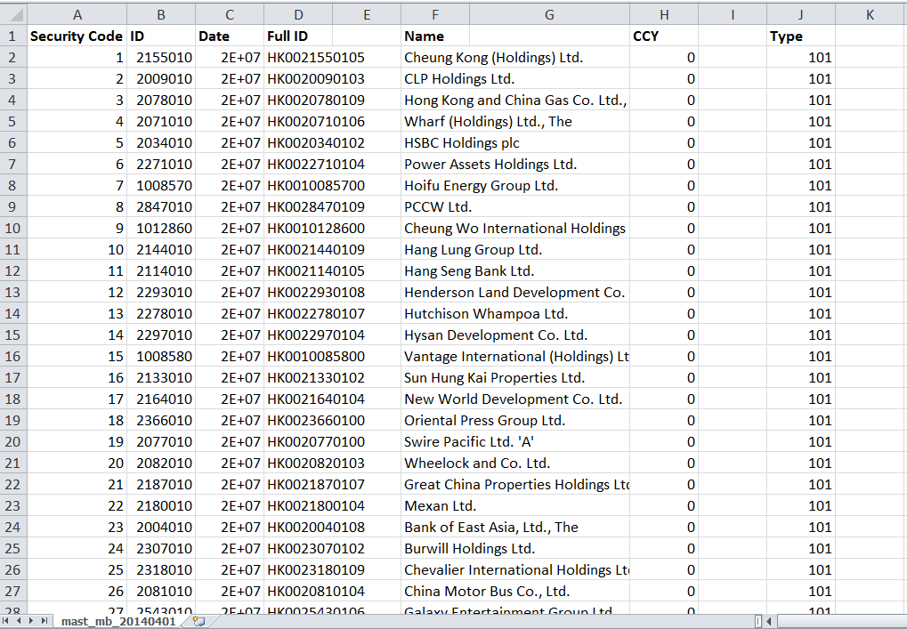
Data Analysis – Historical Tick Data

Slide 50
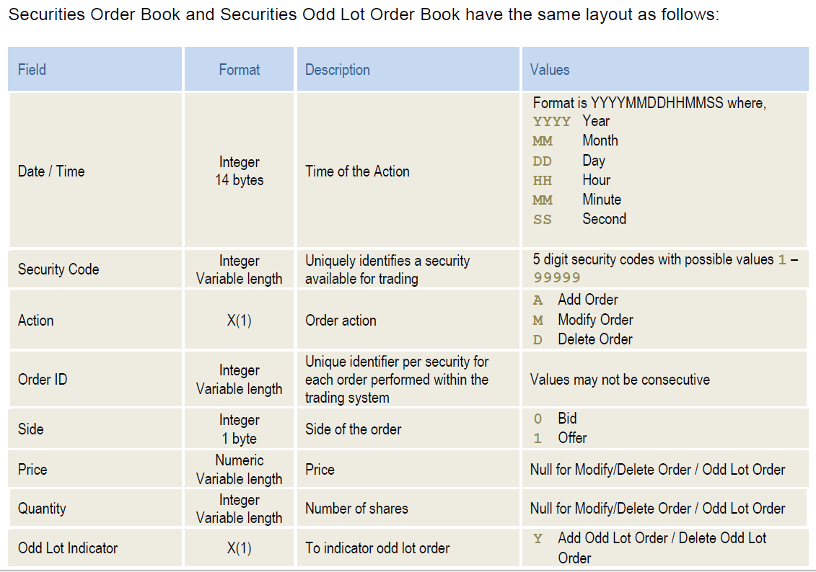
Data Analysis – Historical Tick Data

Slide 51
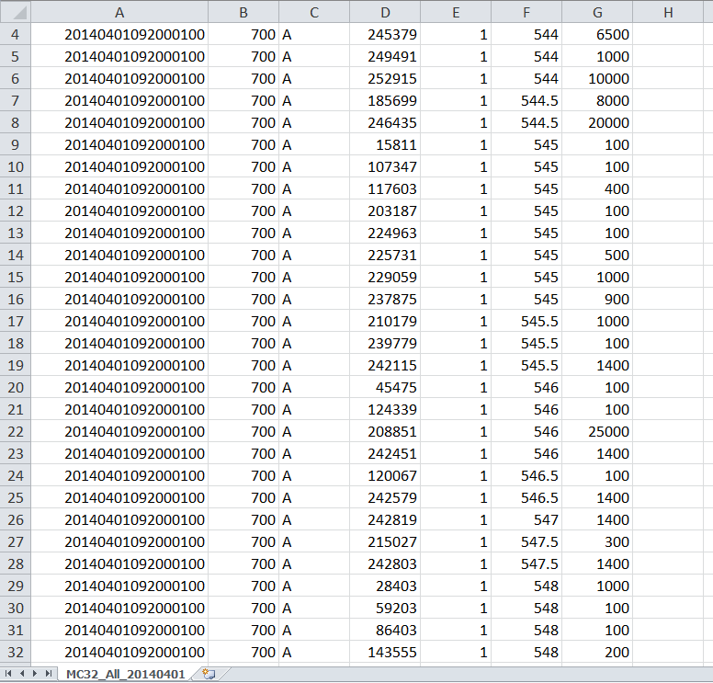
Data Analysis – Historical Tick Data
Date/Time | Stock | Action | ID | Side | Price | Qty

Slide 52
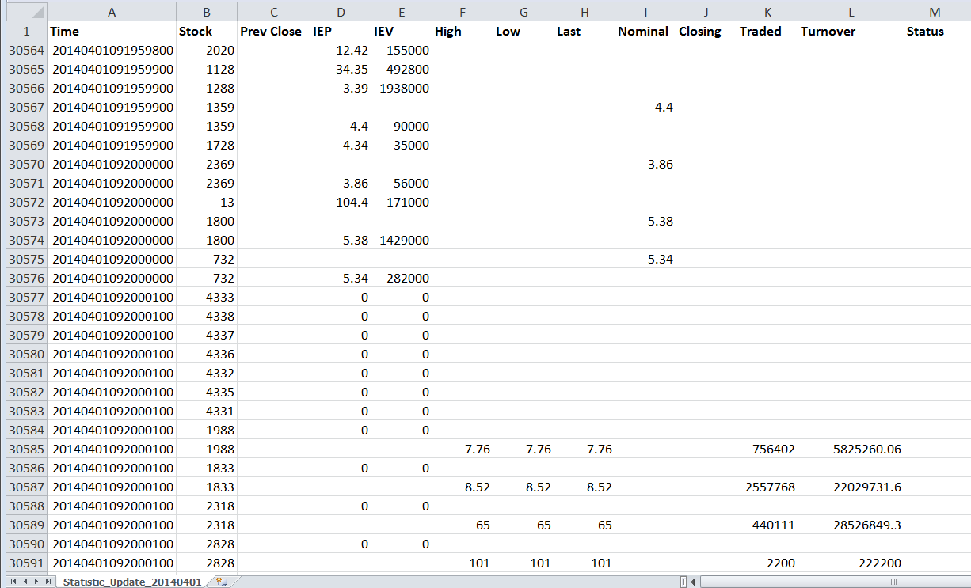
Data Analysis – Historical Tick Data

Slide 53
Trading Signals - Order Book Imbalance
Order Book Imbalance: the average ratio between the best bid and best ask size over a 1-min window. If the average bid size is larger than the ask size (hence a positive ratio), like the example below, it indicates the price is more likely to go up. Vice versa, the price is more likely to go down.
1min-Order Book-Imbalance = Avg (Log(Best BidSize/ Best AskSize))
Options: We can take into account the first few levels (for example 3 levels) of the order book while the top level of the book will have higher weighting. The 1-min duration can also be customized to a shorter or longer duration.
Size | Bid | Ask | Size
1,000,000 | 9.5 | 9.6 | 20,000
500,000 | 9.4 | 9.7 | 50,000
700,000 | 9.3 | 9.8 | 80,000
Notes:
Ask why taking log – because the asymmetry of +ve and –ve ratio

Slide 54
Trading Signals - Money flow
Money flow: when a stock is purchased at a higher price (i.e. Last > Previous Last), it is called uptick and be considered positive money flow. When the next trade is at a lower price (a downtick), this is considered to be negative money flow.
If more shares were bought throughout the 5-min window on the uptick than the downtick, net money flow is positive because more investors were willing to pay a premium for the stock. If money flow is negative when a stock's price is rising, this could spell trouble.
5min-MoneyFlow = Σ( (Last – Previous Last) * Last Size)
Options: The 5-min duration can also be customized to a shorter or longer duration.

Slide 55
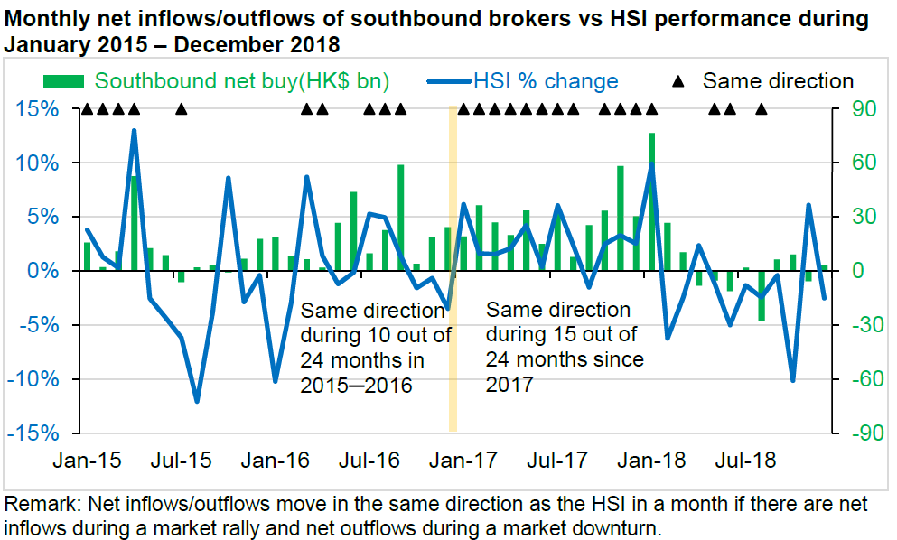
Trading Signals - Money flow

Slide 56
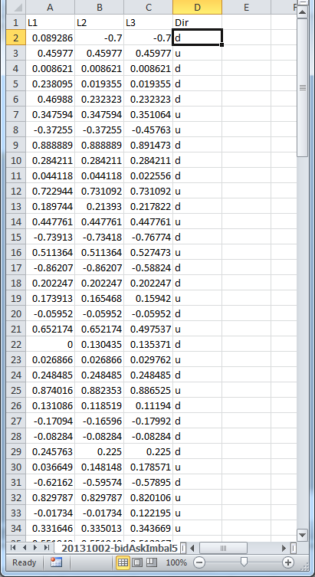
Case Study: Short Term Price Movement
Use Decision Tree to predict short-term stock (5.HK) movement (go up or down) from Order Book Imbalance (OBI) data.
L1: First-1-Level OBI
L2: First-2-Level OBI
L3: First-3-Level OBI
Dir: Mid-Price Direction - u(up) , d (down)
The data normalized to [-1, 1]
Why Data Normalization is necessary for Machine Learning models

Slide 57
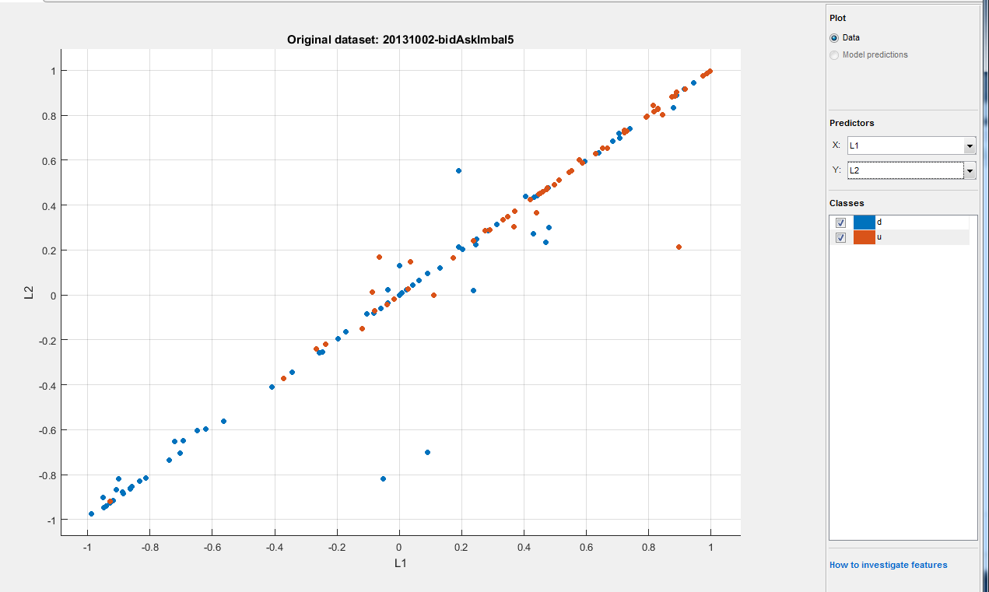
Case Study: Short Term Price Movement
Visualize the data: plotting Level-1 OBI and Level-2 OBI
Brown dots: stock going up, Blue dots: stock going down
More Brown dots (up) when both Level-1 OBI and Level-2 OBI are positive and vice versa

Slide 58
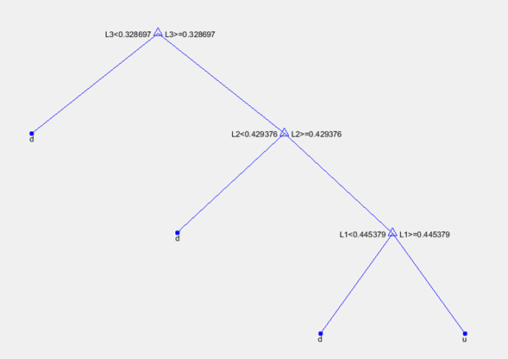
Case Study: Short Term Price Movement
Training Accuracy ~83%
Decision Tree training results for this Stock (0005.HK) to be more likely to go up when:
Level-1 OBI > 0.445379 and Level-2 OBI > 0.429376 and Level-3 OBI > 0.328697

Slide 59
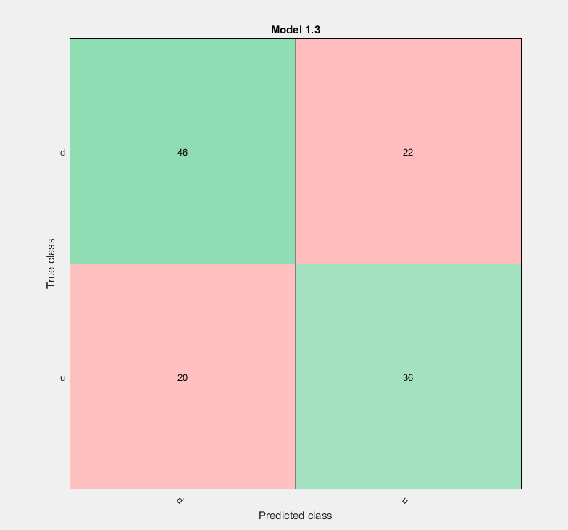
Case Study: Short Term Price Movement
Test Data Performance
Total : 46 + 22 + 20 + 36 = 124
Predicted Correctly: 46 + 36 = 82
Test Accuracy: 82/124 = 66.1% vs 83%
What’s that imply?
Any Improvement suggestions?
Code Example

Slide 60
Case Study: Short Term Price Movement
The “short term price prediction” alone probably cannot be a profitable strategy by itself. However, it can be a sub-module to improve certain aspect of other strategies
Trading Strategies – HK Warrant Follow the Super Trader
Enter Trade when "super user" trade (when a single trade of notation greater than certain amount on a warrant and ask price move up (>= 1 tick) within 10ms to 5s
Exit Trade in these 3 modes
1: Profit mode: Sell if bid + 2 ticks >= avg px
Improve Profit Mode: “Short Term Price Predictor” hints whether to wait a bit longer (Mid-Price Up) or shorter (Mid-Price down)

Slide 61

Surprised Learning - SVM
Support Vector Machine (SVM): a discriminative classifier formally defined by a separating hyperplane.
The goal is to find the hyperplane that gives the largest minimum distance to the training examples. Therefore, the optimal separating hyperplane maximizes the margin of the training data (those data points in solid color that formed the maximum margin are the support vectors)

Slide 62

Surprised Learning - SVM
Nonlinear classification performed by applying kernel transformation
Transform to higher dimension space
https://www.youtube.com/watch?v=3liCbRZPrZA
(Notes: Statistical significance, Curse of Dimensionality)

Slide 63
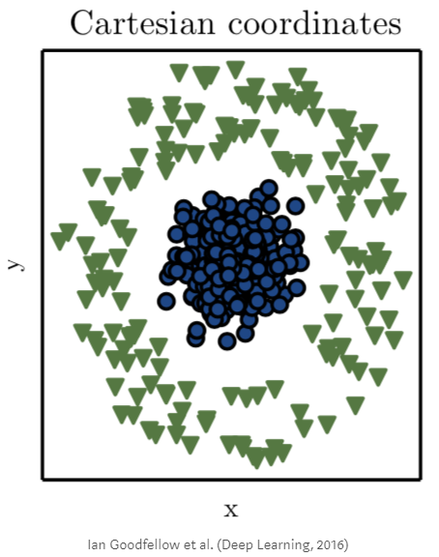
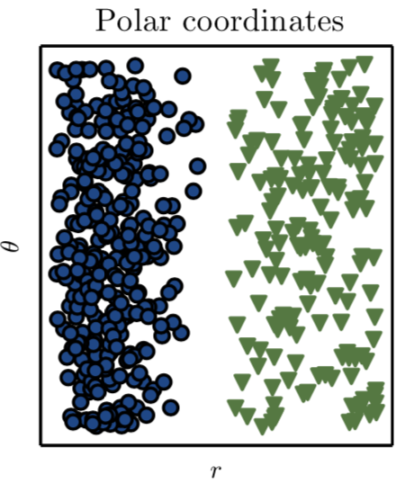
Surprised Learning - SVM
Nonlinear classification performed by applying kernel transformation
Transform to another co-ordinate space

Slide 64

Unsurprised Learning - PCA
Principle Component Analysis: dimension reduction technique used to emphasize variation and bring out strong patterns in a dataset
http://setosa.io/ev/principal-component-analysis/
(Example: Probably don’t need both HSI and tracker fund px to model market sentiment)

Slide 65

Unsurprised Learning – k-Means Clustering
k-means clustering: a type of unsupervised learning (unlabeled data).Find k groups in the data. The algorithm works iteratively to assign each data point to one of k groups based on the features that are provided. Data points are clustered based on feature similarity.
The centroids of the k clusters, which can be used to label new data
Labels for the training data (each data point is assigned to a single cluster)
Example: https://towardsdatascience.com/using-unsupervised-learning-to-plan-a-paris-vacation-geo-location-clustering-d0337b4210de

Slide 66


Unsurprised Learning – k-Means Clustering
Stocks Clustering: cluster the stocks in different groups by their underlying characteristics such as volatility and liquidity profile.

Slide 67

Deep Learning

Slide 68


Deep Learning - Example
Colorize Black & White Photos
http://demos.algorithmia.com/colorize-photos/
http://richzhang.github.io/colorization/
Cloud hosted deep learning models on Algorithmia. The Colorful Image Colorization microservice is a computer vision algorithm trained on a million images from the Imagenet dataset.

Slide 69

Deep Learning – Neural Networks
Connectionism inspired by the biological neural networks that constitute animal brains
Contrast this to Symbolic, Cognitive, Statistical and Evolutionary models (reasoning, generalization etc.)

Slide 70

Deep Learning – Neural Networks
ANN (Artificial Neural Network) consists of multiple layers (One Input/ Output and optionally multiple Hidden layers) of Neurons
The neurons are connected from one layer to another. It can be one direction forward (feed-forward), going backward (recurrent) or self connected (feed-back loop)

Slide 71


Deep Learning – Neural Networks
From the Input data, the network learn the weight parameters to fit the desired output
Activation functions (non-linearity) determine whether a particular neuron will be active (excitation) or not.

Slide 72

Deep Learning - Neural Networks
Back propagation: calculate the error contribution of each neuron after a batch of data. Used by the gradient descent optimization algorithm to adjust the weight of neurons by calculating the gradient of the loss function.
https://mattmazur.com/2015/03/17/a-step-by-step-backpropagation-example/

Slide 73

Visualize Neural Network

Slide 74


Visualize Neural Network

Slide 75
Deep Learning – Breakthrough
Deep Neural Network (DNN) is a type of Neural Network with many layers. Training used to be time consuming while suffering from the vanishing gradient problem. Hardware improvements (cloud, GPU) and separately pre-trained layers in DNN learning helps mitigate the issues
Hinton, G. E., Osindero, S. and Teh, Y (2006). A fast learning algorithm for deep belief nets Neural Computation 18, pp 1527-1554
Neural Network (Deep Learning in particular) is easier to scale by adding neurons and layer to increase the model capacity to take on more complex problems comparing to other analytic models. (any problem here?)
http://playground.tensorflow.org
http://cs.stanford.edu/people/karpathy/convnetjs/

Slide 76

Deep Learning - Types
Long Short-Term Memory (LSTM) and Recurrent Neural Networks (RNN) are designed for sequence modeling.
They should be a good choice to model time series data

Slide 77

Deep Learning vs Other Machine Learning
Deep learning tend to have a lot of parameters, hence requires sufficiently large volume of data to train and more computation power
When the data volume is less, traditional methods tend to perform better that deep-learning ones. However, when the data volume is huge, the deep-learning method wins over traditional methods. (Hence Deep Learning is more scalable)
Ref: The Number of Hidden Layers

Slide 78

Deep Learning vs Other Machine Learning
Deep Learning model can scale easily and with thousands or million parameters to model. It’s very powerful but the problem is……….

Slide 79
Deep Learning – CNN
Convolutional Neural Networks (CNN) for Visual Recognition
http://cs231n.stanford.edu/
https://www.youtube.com/watch?v=vT1JzLTH4G4&list=PLC1qU-LWwrF64f4QKQT-Vg5Wr4qEE1Zxk
The most accurate image recognition technique and win the ImageNet (Image database just like the corpus to the text data) competition
http://www.image-net.org/

Slide 80

Deep Learning – CNN
CNN’s image representation at different layers is similar to how the brain processes visual information
Human sees structure/region (not pixel)
Use convolution in place of general matrix multiplication in at least one of their layers to learn the feature in a region

Slide 81


Deep Learning – CNN
Dense layers learn global patterns in their input feature space (MNIST-digit patterns involving all pixels), whereas convolution layers learn local patterns: in the case of images, patterns found in small 2D windows of the inputs (3 × 3 window size).
Learn spatial hierarchies of patterns. A first convolution layer will learn small local patterns such as edges, a second convolution layer will learn larger patterns made of the features of the first layers, and so on. This allows convnets to efficiently learn increasingly complex and abstract visual concepts (visual world is fundamentally spatially hierarchical).

Slide 82

Deep Learning – CNN

Slide 83

Deep Learning – LSTM
Code Example: LSTM – Bitcoin Time Series

